Slide 1
TONE Practice #3
Bush at Ground Zero
OVERparenting

Slide 2
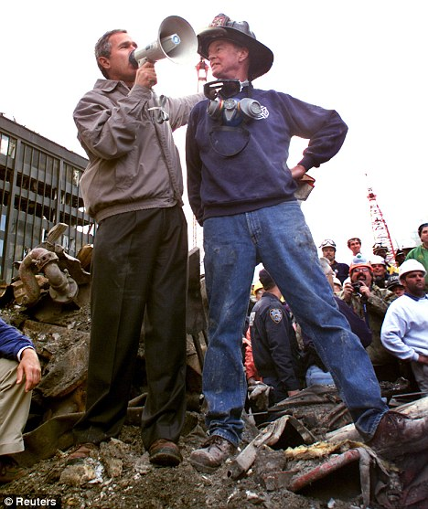
Recall the Bush speech at Ground Zero after 9/11:
“The rest of the world hears you. And people who knocked down these buildings will hear all of us soon.”
Which of the following best articulates the tone?
Apathetic
Embarrassed
Defiant
Delighted

Slide 3
Recall the TEDTalk about over-parenting and the “checklisted childhood.”
“And then with our kids, our precious kids, we spend so much time nudging, cajoling, hinting, helping, haggling, nagging as the case may be, to be sure they're not screwing up, not closing doors, not ruining their future, some hoped-for admission to a tiny handful of colleges that deny almost every applicant.”
Which of the following best articulates the author’s tone in the excerpt?
Objective
Lamenting
Optimistic
Proud

Slide 4
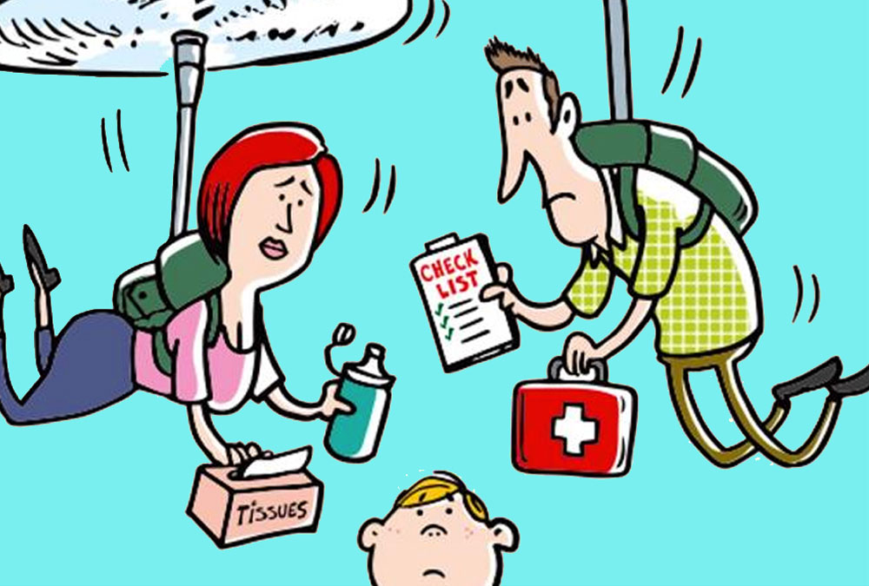
Recall the TEDTalk again:
“When we raise kids this way, and I'll say we, because Lord knows, in raising my two teenagers, I've had these tendencies myself, our kids end up leading a kind of checklisted childhood. “
Which of the following best articulates the tone?
Self-deprecating
Cautionary
Hopeful
Complimentary

